Slide 1


FULL STACK WEB DEVELOPMENT WITH DJANGO
Lecture 21

Slide 2

Today’s Agenda
Developing Our Django App
Using Django’s Form Library

Slide 3
The Django Form Library
Django comes with a form library, called django.forms, that handles many of the issues we’ve seen in the previous codes like displaying form as HTML form to validation.
Let’s create a contact form application using the Django forms framework.

Slide 4
Performing Initial Steps
Create a folder called mytwelfthvsdjangoproject in djangoexamples.
Load it in the VS CODE
Create a django project called djangoformproj by using the command:
django-admin startproject djangoformproj
This will create the outer project folder called djangoformproj and inner app folder also by the same name

Slide 5
Performing Initial Steps
Now go to the outer project folder djangoformproj and create an app called djangoformapp by using the command:
django-admin startapp djangoformapp
Now create a folder called templates in the outer project folder and inside templates create a folder called djangoformapp and within it create an HTML file called contact_form.html
Finally update settings.py so that it contains the name of our app and the template directory path

Slide 6
Performing Initial Steps
Code:
INSTALLED_APPS = [
'django.contrib.admin',
'django.contrib.auth',
'django.contrib.contenttypes',
'django.contrib.sessions',
'django.contrib.messages',
'django.contrib.staticfiles',
'djangoformapp',
]

Slide 7
Performing Initial Steps
Code:
TEMPLATES = [
{
'BACKEND': 'django.template.backends.django.DjangoTemplates',
'DIRS': [os.path.join(BASE_DIR,'templates')],
…..
}

Slide 8
Creating Form Class
The primary way to use the forms framework is to define a Form class for each HTML <form>you’re dealing with.
In our case, we only have one <form>, so we’ll have one Form class.
This class can live anywhere we want – including directly in our views.py file – but community convention is to keep Form classes in a separate file called forms.py.
So ,create this file in the same directory as views.py, and enter the code given on next slide

Slide 9
Creating Form Class
from django import forms
class ContactForm(forms.Form):
subject = forms.CharField()
email = forms.EmailField(required=False)
message = forms.CharField()

Slide 10
Understanding Our Form Class
Our form class called ContactForm is similar to Django’s model syntax.
It has to inherit the predefined class forms.Form
Each field in the form is represented by a type of Field class – CharField and EmailField are the only types of fields used here – as attributes of a Form class.
Each field is required by default, so to make email optional, we specify required=False.

Slide 11
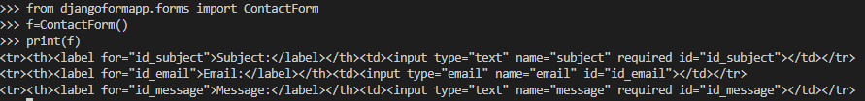
Understanding Our Form Class
Let’s hop into the Python interactive interpreter and see what this class can do.
The first thing it can do is display itself as HTML:

Slide 12
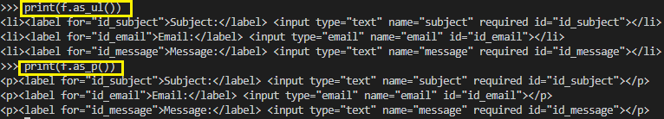
Understanding Our Form Class
Django adds a label to each field, along with <label> tags for accessibility. The idea is to make the default behavior as optimal as possible.
This default output is in the format of an HTML <table>, but there are a few other built-in outputs:

Slide 13
Understanding Our Form Class
Note that the opening and closing <table> , <ul> and <form> tags aren’t included in the output, so that we can add any additional rows and customization if necessary.
These methods are just shortcuts for the common case of “display the entire form.” We can also display the HTML for a particular field:

Slide 14
Understanding Our Form Class
The second thing Form objects can do is validate data.
To validate data, create a new Form object and pass it a dictionary of data that maps field names to data:

Slide 15

Understanding Our Form Class
Once we’ve associated data with a Form instance, we’ve created a “bound” form:
>>> f.is_bound
True
Call the is_valid() method on any bound Form to find out whether its data is valid.
We’ve passed a valid value for each field, so the Form in its entirety is valid:
>>> f.is_valid()
True

Slide 16


Understanding Our Form Class
If we don’t pass the email field, it’s still valid, because we’ve specified required=False for that field:
But, if we leave off either subject or message, the Form is no longer valid:

Slide 17

Understanding Our Form Class
Each bound Form instance has an errors attribute that gives us a dictionary mapping of field names to error-message lists:

Slide 18

Understanding Our Form Class
We also can drill down to get field-specific error messages:

Slide 19

Understanding Our Form Class
Finally, for Form instances whose data has been found to be valid, a cleaned_data attribute is available.
This is a dictionary of the submitted data, “cleaned up.”
Django’s forms framework not only validates data, it cleans it up by converting values to the appropriate Python types.

Slide 20
Connecting Form Object To Views
Now that we have knowledge about Form classes, we might see how we can use this infrastructure to design our Contact Form App.
We will have to do the following:
Create a view function called contact( ) to render the form object
Create a template called contact_form.html to display form
Create a template called thankyou.html to display the form data

Slide 21
Creating The contact( )View
At first we will create a view function called contact() , which will do the following:
Check whether the request is POST or not. To do this we can use the method attribute of request object whose value is either “POST” or “GET”
If it is not POST then our view function will simply create a ContactForm object and render this form object to the html page contact_form.html
If it is POST request then it means that the user must have submitted the form by pressing submit key.
Now the view function will check whether the form is valid or not . If it is not valid then it will render the page contact_form,html sending it the form object ( which contains errors)
If the form is valid then the view function will retrieve all the form data sent by the HTML page , create a ContactForm object with this data and retrieve the values from the ContactForm object by using it’s cleaned_data dictionary
Then it will send these values to the page thankyou.html which will display these values

Slide 22
The contact( )View Function
from django.shortcuts import render
from djangoformapp.forms import ContactForm
def contact(request):
if request.method == 'POST':
form = ContactForm(request.POST)
if form.is_valid():
cd = form.cleaned_data
subj=cd['subject']
msg=cd['message']
mail=cd['email']
context={'subject':subj,'message':msg,'email':mail}
return render(request, 'djangoformapp/thankyou.html', context)
else:
form = ContactForm()
return render(request, 'djangoformapp/contact_form.html', {'form': form})

Slide 23
Creating The contact_form.html Page
Now we will design the contact_form.html page , which will do the following:
Check whether the form contains errors or not. It will happen only when the user has submitted an incomplete form.
If it contains errors then the message “please correct the errors below is displayed”
Then we will have standard HTML form with POST as method . Also we will have to use the novalidate attribute in the <form> tag. When using HTML5 in some of the latest browsers (notably Chrome), form fields will be automatically validated by the browser. As we want Django to handle form validation, the novalidate attribute tells the browser not to validate the form.
Then we will have to render the render the form fields. We want to display form as table , so the as_table attribute will render the form fields as table rows. Django doesn’t render the table tags or the submit button, so we will have to add these tags at the end.
Also we will have to use the {% csrf_token %}template tag because all POST forms that are targeted at internal URLs must use the {% csrf_token %}template tag. This is to protect against Cross Site Request Forgeries (CSRF).

Slide 24
Creating The contact_form.html Page
<html>
<head>
<title>Contact us</title>
</head>
<body>
<h1>Contact us</h1>
{% if form.errors %}
<p style="color: red;">
Please correct the error{{ form.errors|pluralize }} below.
</p>
{% endif %}
<form action="" method="post" novalidate>
<table>
{{ form.as_table }}
</table>
<input type="submit" value="Submit">
{% csrf_token %}
</form>
</body>
</html>

Slide 25
Running The App
To run the app we have coded till now we will have to make entries in the urls.py of the project level as well as the app level.
Project level urls.py:
from django.contrib import admin
from django.urls import path,include
urlpatterns = [
path('admin/', admin.site.urls),
path('',include('djangoformapp.urls')),
]
App level urls.py:
from django.urls import path
from . import views
urlpatterns = [
path('contact/',views.contact,name='contact'),
]

Slide 26
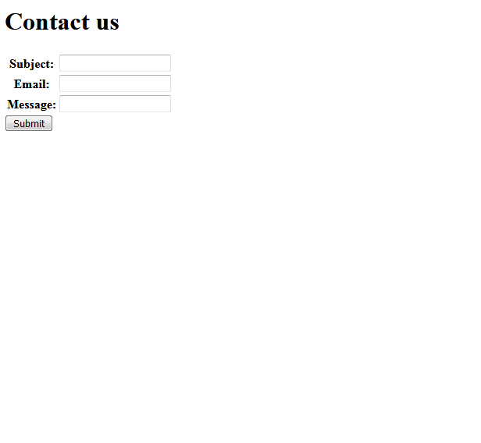
Running The App
Now start the server and open the page http://localhost:8000/contact and
this will load the page contact_form.html with the following output:

Slide 27
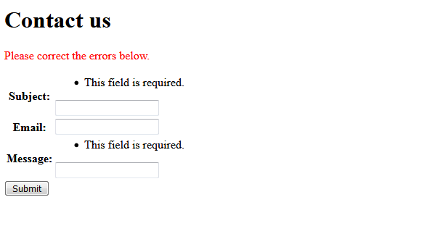
Running The App
Now simply click the submit button , without filling any data and we will see
django form errors in action

Slide 28
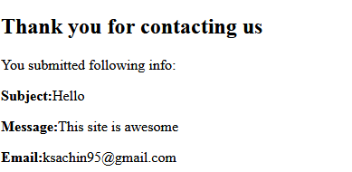
Running The App
Now properly fill all the data and then click the submit button

Slide 29
Using Form Widget
Probably the first thing we’ll notice when we render this form locally is that the message field is displayed as an <input type="text">, and it ought to be a <textarea>.
We can fix that by setting the field’s widget:
from django import forms
class ContactForm(forms.Form):
subject = forms.CharField()
email = forms.EmailField(required=False)
message = forms.CharField(widget=forms.Textarea)

Slide 30
Specifying Labels
By default, the labels on Django’s auto-generated form HTML are created by replacing underscores with spaces and capitalizing the first letter – so the label for the email field is "Email".
But, we can customize the label for a given field.
Just use label, like so:
class ContactForm(forms.Form):
subject = forms.CharField(max_length=100)
email = forms.EmailField(required=False, label='Your e-mail address')
message = forms.CharField(widget=forms.Textarea)

Slide 31
Custom Validations
There are a number of ways to hook custom validation into a Django form.
If our rule is something we will reuse again and again, we can create a custom field type.
Suppose we want additional validation on the message field, so we add a clean_message() method to our Form class

Slide 32
Custom Validations
from django import forms
class ContactForm(forms.Form):
subject = forms.CharField(max_length=100)
email = forms.EmailField(required=False)
message = forms.CharField(widget=forms.Textarea)
def clean_message(self):
message = self.cleaned_data['message']
num_words = len(message.split())
if num_words < 4:
raise forms.ValidationError("Not enough words!")
return message

Slide 33
Explanation
Django’s form system automatically looks for any method whose name starts with clean_ and ends with the name of a field. If any such method exists, it’s called during validation.
Specifically, the clean_message() method will be called after the default validation logic for a given field (in this case, the validation logic for a required CharField).
Because the field data has already been partially processed, we pull it out of self.cleaned_data.
Also, we don’t have to worry about checking that the value exists and is non-empty; that’s done by the default validator.

Slide 34
Explanation
We naively use a combination of len() and split() to count the number of words.
If the user has entered too few words, we raise a forms.ValidationError.
The string attached to this exception will be displayed to the user as an item in the error list.

Slide 35
Explanation
It’s important that we explicitly return the cleaned value for the field at the end of the method.
If we forget the return statement, then None will be returned, and the original value will be lost.

Slide 36
Customizing The Form
Our contact_form.html template uses {{ form.as_table }} to display the form, but we can customize forms’ presentation with CSS.
The following CSS really makes our errors stand out
ul.errorlist {
margin: 0;
padding: 0;
}
.errorlist li {
background-color: red;
color: white;
display: block;
font-size: 10px;
margin: 0 0 3px;
padding: 4px 5px;
}

Slide 37
Customizing The Form
Write the CSS code shown in the previous slide in main.css file created at the following location in the outer djagoformproj folder at the following location:
djangoformproj
static
css
main.css

Slide 38
Customizing The Form
Now in the settings.py file make the following entry:
STATICFILES_DIRS=[os.path.join(BASE_DIR,'static'),]

Slide 39
Customizing The Form
Finally we have to use this css file in the contact_form.html template so to do this we need to take 2 steps:
Mention the template tag {% load staticfiles %} in the <head> section of contact_form.html page
Add the <link> tag in the <head> section with the following code:
<link href="{% static 'css/main.css' %}" rel="stylesheet" type="text/css">

Slide 40
The Modified contact_form.html Page
<html>
<head>
{% load staticfiles %}
<title>Contact us</title>
<link href="{% static 'css/main.css' %}" rel="stylesheet" type="text/css">
</head>
<body>
<h1>Contact us</h1>
{% if form.errors %}
<p style="color: red;">
Please correct the error{{ form.errors|pluralize }} below.
</p>
{% endif %}
<form action="" method="post" novalidate>
<table>
{{ form.as_table }}
</table>
<input type="submit" value="Submit">
{% csrf_token %}
</form>
</body>
</html>

Slide 41
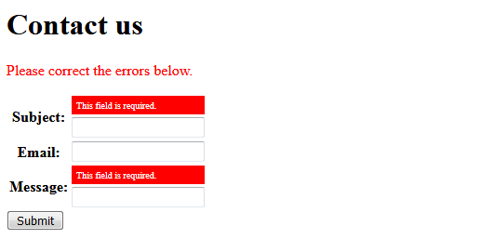
The Output

